Slide 1
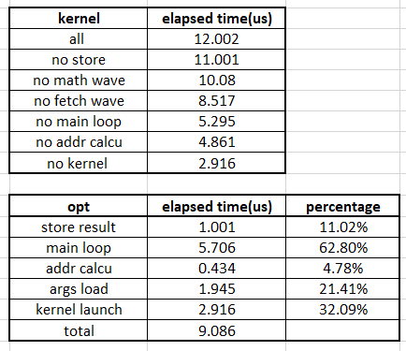
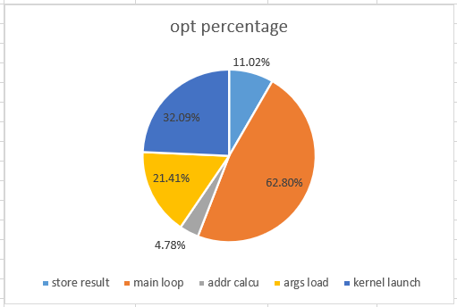
480 * 512 kernel analysis
Different Operations percentage

Slide 2
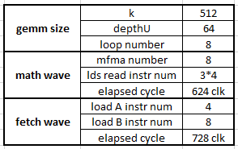
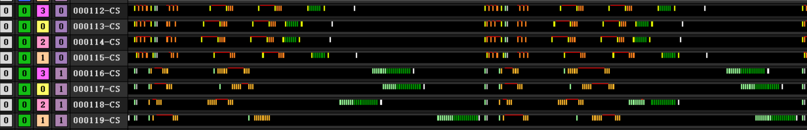
480 * 512 kernel analysis
Main loop elapsed time
3bubbles
88 clk between buff_load_A and buffer_load_B (13.7%)
300 clk between buff_load and addr calcu (41.2%)
Math wave waits fetch wave 280 clk (38.5%)
3
1
2

